Slide 1
A Critical Introduction to Economics Slides based on the book by Jäger/Springler: Ökonomie der Internationalen Entwicklung. Eine kritische Einführung in die Volkswirtschaftslehre Chapter 3: The State, the Society and the Economy

Slide 2
The State, the Society and the Economy
What‘s the role of states and markets and how are they related?
Neoclassical economics
Keynesianism
Political economy
General approach
Key concepts
Implications for economic policy

Slide 3
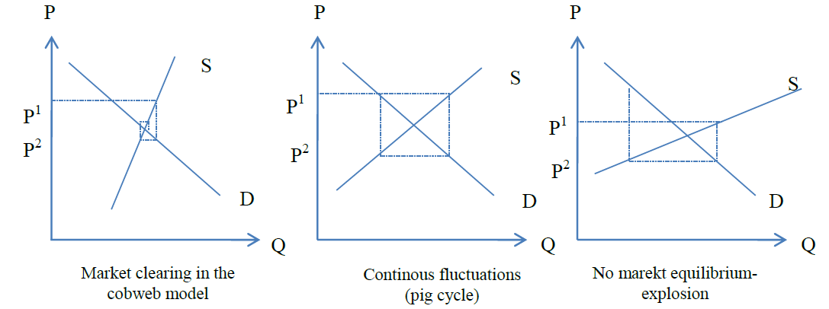
3.1.1 Neoclassical economics: general approach
The superiority of markets
Market imperfections (market failure)
State failure
Cobweb model to market equilibrium

Slide 4
Pre-concitions for perfect markets (in the short run)
Freedom to set up contracts
Protection of private property
Existing legal framework
Competitive market requires
Many buyers and sellers
No barriers to entry
Identical goods
Perfect information

Slide 5
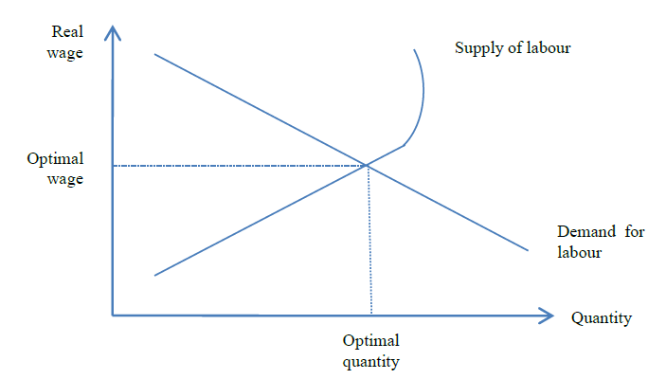
The labour market as a „normal“ market
Simultanous equilibrium at all markets
Equilibrum wage at the labour market

Slide 6
3.1.2 Key-concepts in neoclassical economics (1)
Markte imperfections that do no lead to a market solution
Public goods
Not excludable
No rivalry in consumption
Natural monopolies
No market provision because of high fixed costs
Separate infrastructure and provision

Slide 7
3.1.2 Key-concepts in neoclassical economics (2)
Market imperfections that lead to an undesired market result
Externalities
Asymmetric information

Slide 8
(1) Externalities
Negative Externalities and positive externalities (Social value exceeds private value)
Private solutions
Moral codes and social sanctions
Charitable organizations
Coase theorem: well defined property rights, low transaction costs allow for private solutions
Command-and-Control Policies
Usually take the form of regulations:
Forbid certain behaviour
Require certain behaviour
Market-Based Policies
Taxes and subsidies
Tradable pollution permits
Notes:
8

Slide 9
(2) Asymmetric information
The “lemons” problem: When some people know more than others market failures may result:
Adverse selection
Moral hazard
Privates try to reduce asymmetric information by signaling and screening, monitoring
asymmetric information may call for government action: increase transparency

Slide 10
3.1.3 Implications for economic policy
How to prevent market failure?
Direct intervention
Indirect intervention
Reasons for state failure:
The existence of lobbyists
Political business cycle

Slide 11
3.2.1 Keynesianism: general approach
Macroeconomic market failure
No equilibrium but unemployment in the labour market: critique of the neoclassical model of the labour market
State intervention is necessary to stabilize the economy

Slide 12
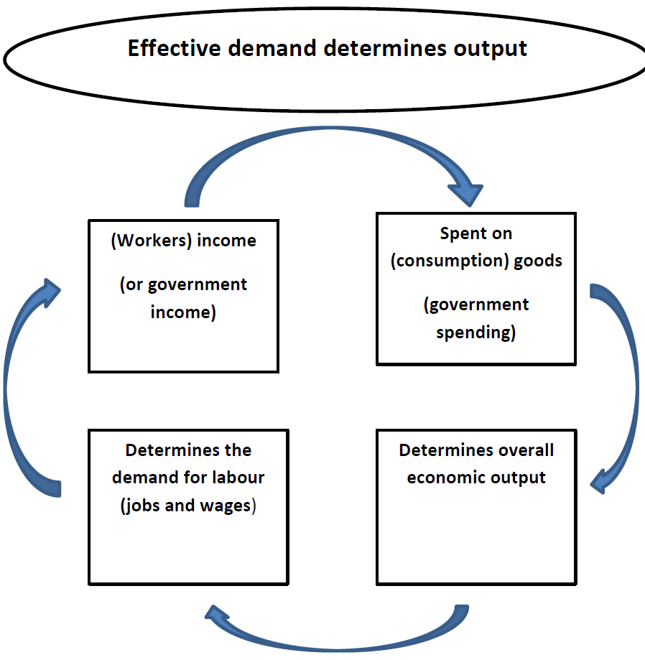
3.2.2 Key-concepts in Keynesianism
The labour market in a Keynesian (Kaleckian) perspective
Demand for labour depends on effective demand (output)

Slide 13
(1) The Labour market tends towards under-employment

Slide 14
3.2.3 Implications for economic policy
Active state is required to keep output at a highl level → high level of employment (critiziced by neoclassical NPE and theory of rational expectations)
Stabilize expectations (to reduce uncertainty)
Provide institutions that stabilize wages
Active state intervention by using fiscal policy: (functional finance, fine-tuning)

Slide 15
Fiscal policy and deficit spending
Functional Finance:
G-T = S(Y_{f}) – INV (Y_{f}) [+ M (Y_{f}) – X (WY)]
“Crowding-in” instead of “crowding out”
Multiplier effect: m = 1/(1-MPC)
→Fiscal stablization
→State as “employer of last resort”

Slide 16
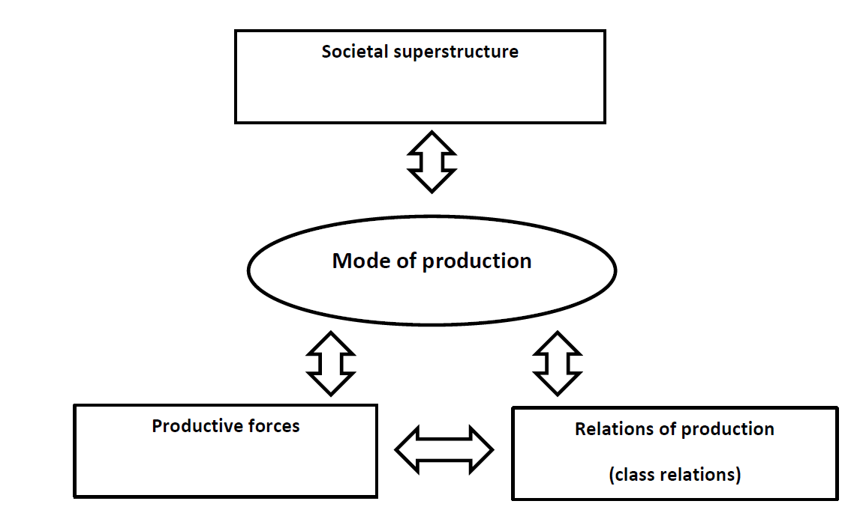
3.3.1 Political Economy: general approach
Integrative analysis of the economy, the society and the state (societal superstructure)
Different types of power: relational power, strategic power, structural power) in a class society
Modern capitalism emerged with modern state (intrinsically related)

Slide 17
3.3.2 Key-concepts in Political Economy
Functionalist state theory
Instrumentalist state theory
The state as an expression of condensed societal (class) relations
Historical forms of statehood

Slide 18
(1) The state as an expression of condensed societal (class) relations
Relative autonomy of the state
Strategic selectivity
State-civil society nexus
Hegemony and organic intellectuals
Common sense and counter-hegemony

Slide 19
(2) Historical forms of statehood
Liberal minimal state
Fordist welfare state
National (neo-liberal) workfare state

